Slide 1
All Library Access System SA 41 team 10B
Muthumaheswaran Poornima
Mamta Choudhary
Weng Jin
Wang Juan
Notes:
Introduce every team member

Slide 2
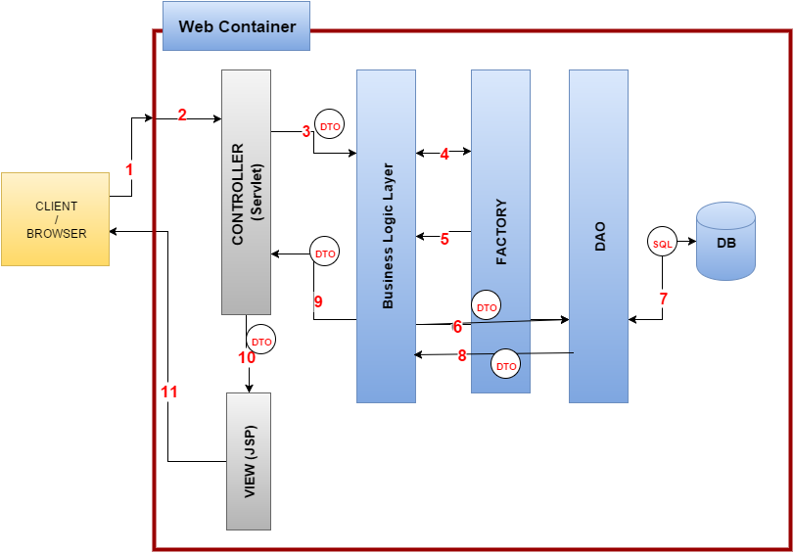
ALAS System Architecture

Slide 3
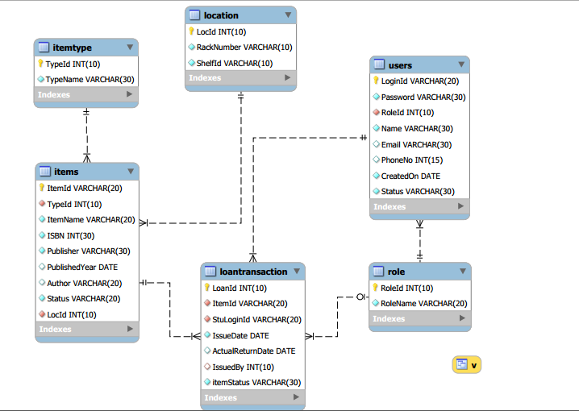
E-R MODEL

Slide 4
What we learnt from this project
Web Application development using JSE and JEE:
client-server Architecture.
Design pattern
MVC 2
DAO
Factory
Technologies/Programming language
Java, JDBC, Servlet, JSP[EL, tags, directives],
HTML and CSS
JavaScript (client side validation),
JQuery
Application development practices like development & debugging using eclipse IDE, code merge and unit testing.
Notes:
What we learn from this project.

